Slide 1
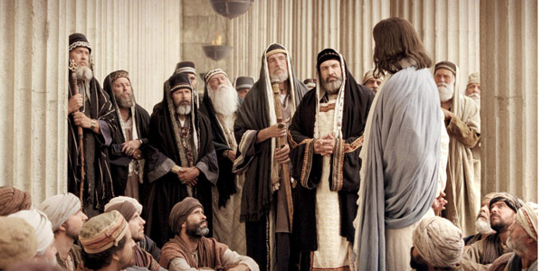
A Question Jesus Refused To Answer
耶稣拒绝回答的问题
Mark 马可福音11:27-33

Slide 2
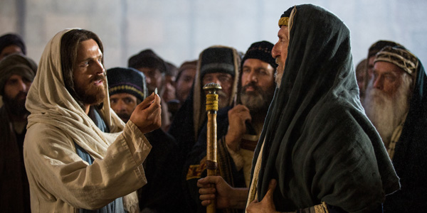
Jesus was often asked a question, and almost always he gave an answer
耶稣经常被问问题，他几乎总是
给出答案

Slide 3
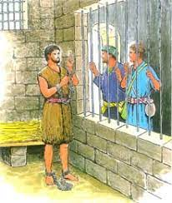
Samples 例子
“Are you the one who was to come, or should we expect someone else? ”
“那将要来的是你吗？还是我们等候别人呢？”
Matt. 太11:3
A: 4-6

Slide 4
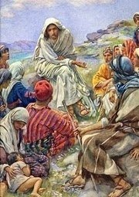
Then the disciples came and said to him, “Why do you speak to the people in parables?”
门徒进前来，问耶稣说：“对众人讲话为什么用比喻呢？”
Matt.太13:10
A: 11-15

Slide 5
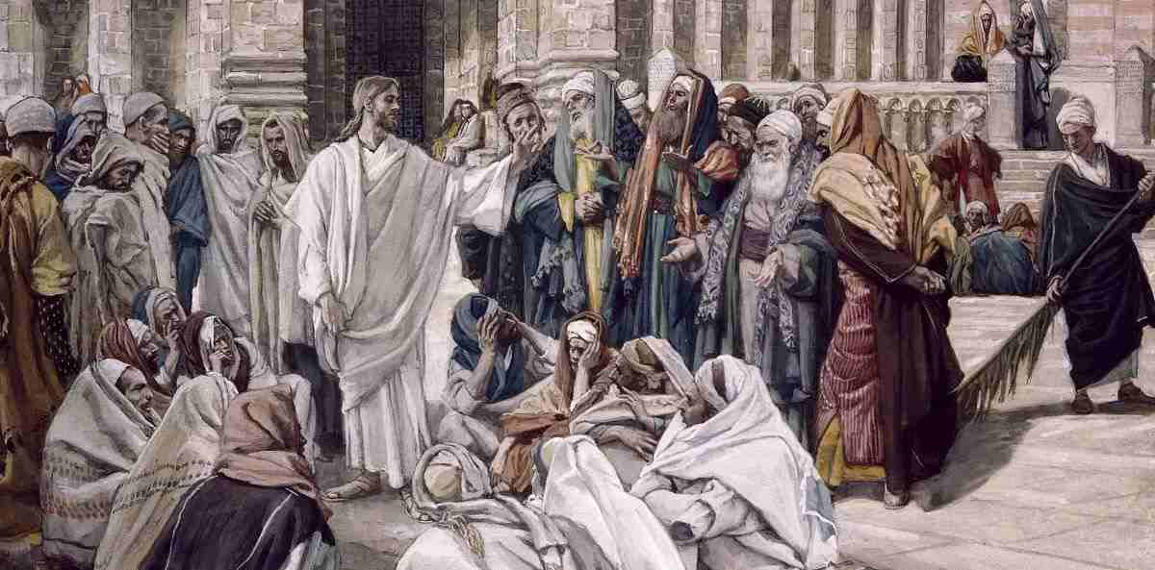
“Why do your disciples break the tradition of the elders? For they do not wash their hands when they eat.”
“你的门徒为什么犯古人的遗传呢？因为吃饭的时候，他们不洗手。”
Matt.太15:2
A: 3-9

Slide 6
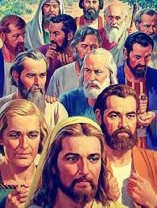
At that time the disciples came to Jesus, saying, “Who is the greatest in the kingdom of heaven?”
当时，门徒进前来，问耶稣说：“天国里谁是最大的？”
Matt.太18:1
A: 2-9

Slide 7
Then Peter came up and said to him, “Lord, how often will my brother sin against me, and I forgive him? As many as seven times?”
那时，彼得进前来，对耶稣说：“主啊，我弟兄得罪我，我当饶恕他几次呢？到七次可以吗？
Matt.太18:21
A: 22-35

Slide 8
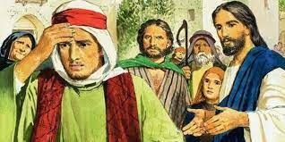
And behold, a man came up to him, saying, “Teacher, what good deed must I do to have eternal life?”
有一个人来见耶稣说：“夫子 ，我该做什么善事才能得永生？”
Matt.太19:16
A: 17-22

Slide 9
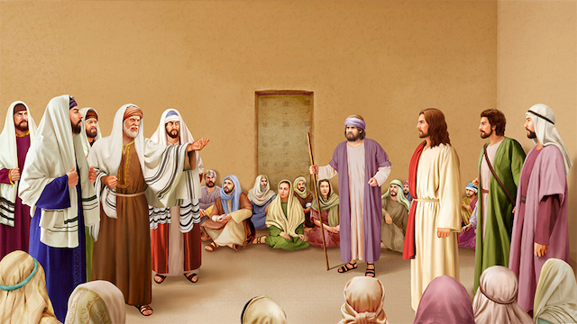
Observations on the Q/A pattern
对问题问答模式的观察
The question appears - surprising, unexpected and unnecessary
问题好像 – 令人惊讶、意外和不必要

Slide 10
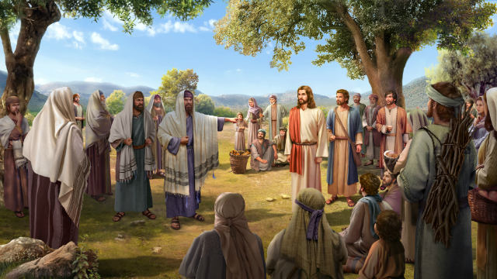
The answer – equally surprising and unexpected
回答 – 同样令人惊讶和意外

Slide 11
Mark 马可福音11:27-33
Scripture reading today Jesus was asked three questions
今天所读的经文，耶稣被问了三个问题

Slide 12
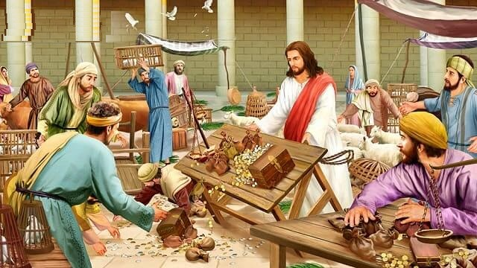
“By what authority are you doing these things, who gave you authority to do this?”
“你仗着什么权柄做这些事？给你这权柄的是谁呢？”
Mark可11:28

Slide 13
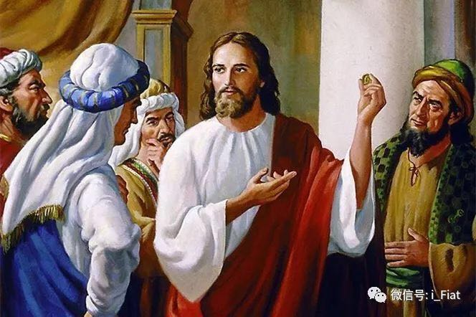
“… Is it right to pay taxes to Caesar or not? Should we pay or shouldn’t we?”
“… 纳税给恺撒可以不可以？我们该纳不该纳? ”
Mark可12:14-15

Slide 14
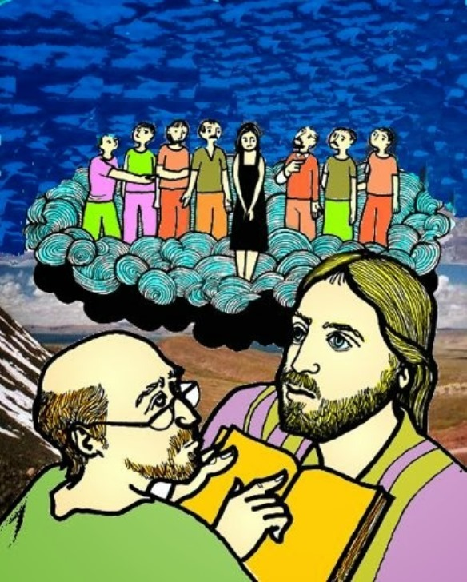
“At the resurrection whose wife will she be, since the seven were married to her?”
“当复活的时候，她是哪一个的妻子呢？因为他们七个人都娶过她。”
Mark可12:23

Slide 15
“By what authority are you doing these things, who gave you authority to do this?” “你仗着什么权柄做这些事？给你这权柄的是谁呢？”
Mark可11:28
Jesus said, “if you won’t answer my question I won’t answer yours”
耶稣说：“我也不告诉你们我仗着什么权柄做这些事。”

Slide 16
“Are you the king of the Jews…Again Pilate asked him, ‘Aren’t you going to answer? People are accusing you of things.’”
彼拉多问他说：“你是犹太人的王吗？”耶稣回答说：“你说的是。” 祭司长告他许多的事。 彼拉多又问他说：“你看，他们告你这么多的事，你什么都不回答吗？”
Mark可15:2-4

Slide 17
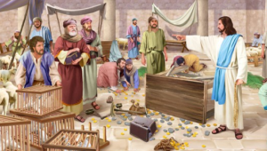
“By what authority are you doing THESE THINGS?” “你仗着什么权柄做这些事？”
Mark可11:28

Slide 18
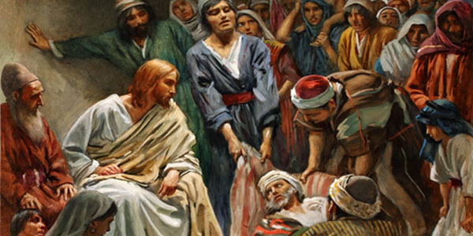
Jesus said of himself 耶稣说他自己
“But that you may know that the Son of Man has authority on earth to forgive sins” “但要叫你们知道，人子在地上有赦罪的权柄。”

Slide 19
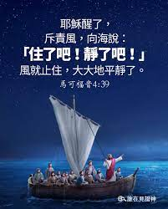
The authority of Jesu 耶稣的权柄
He calmed a raging sea
他平静了汹涌的大海
He drove the evil out of a possessed person
他赶出被鬼附的人身上的鬼

Slide 20
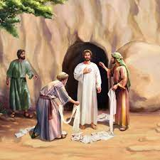
The authority of Jesu 耶稣的权柄
he healed people and raised some from the dead
他医治疾病并使一些人从死里复活
He forgave somebody else’s sin
他赦免了别人的罪

Slide 21
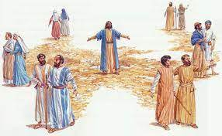
The authority of Jesu 耶稣的权柄
He sent his disciples out two by two and gave them authority over evil spirits. 他差遣门徒并赐给他们制服邪灵的权柄。
Mark
可6:7

Slide 22
The authority of Jesu 耶稣的权柄
Who, being in the very nature God, did not consider equality with God something to be grasped, but made himself nothing, taking the very nature of a servant/a slave. 他本有神的形象，不以自己与神同等为强夺的， 反倒虚己，取了奴仆的形象，成为人的样式；
Phil. 腓2:6-7

Slide 23
“By what authority are you doing THESE THINGS?” “你仗着什么权柄做这些事？”
Mark可11:28
What is the answer? 答案是什么?

Slide 24
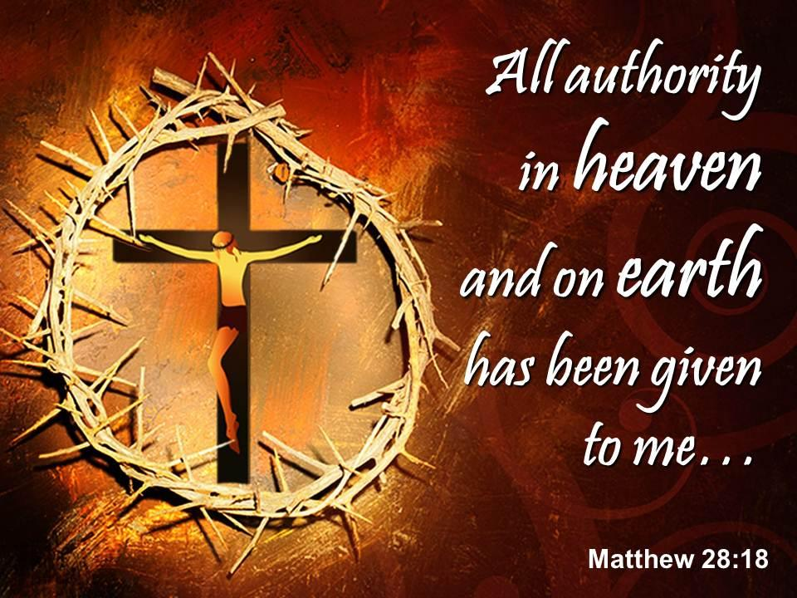
Great Commission 大使命
Matt.
太 28:18
天上地下所有的权柄都赐给我了

Slide 25
To what degree does Jesus have authority over my life, your life? Who is in charge of my life?
耶稣对我的生命和你的生命有多大的权柄？
谁管理我的生活？

Slide 26
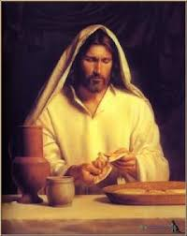
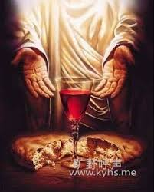
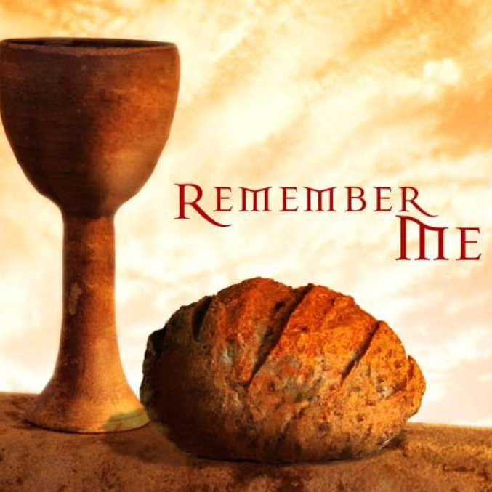
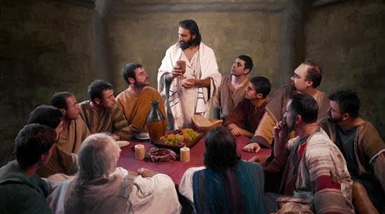
Holy Communion
圣餐

